Slide 1

High Performance
CUDA Programming
Ratul K. Saha

Slide 2
Outline
  Introduction
  CUDA architecture
  Programming model through CUDA
  CUDA programming in Google-Colab
  Conclusion

Slide 3
Book you may follow :
CUDA by Example: An Introduction to General-Purpose GPU Programming. Book by Edward Kandrot and Jason Sanders.
Hands-On GPU Programming with Python and CUDA: Explore High-performance Parallel Computing with CUDA. Book by Bhaumik Vaidya
Cuda For Engineers An Introduction To High-Performance Parallel Computing by Mete Yurtoglu and Duane Storti, PEARSON INDIA

Slide 4
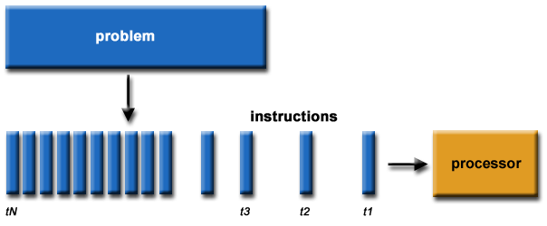
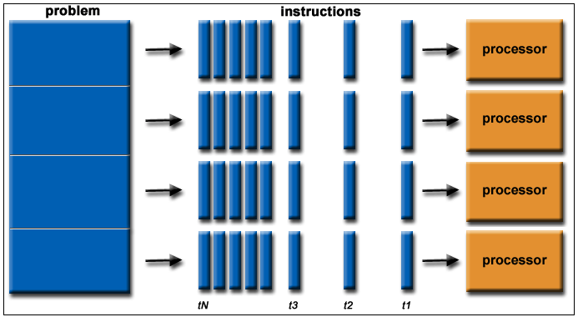
Introduction
  What is serial/sequential processing ?
  Information processing in which only one sequence of processing operations is carried on at a time.
  CPU processor involvement : 1
  What is parallel computing ?
  Parallel processing is a method in computing in which separate parts of an overall complex task are broken up and run simultaneously on multiple CPUs.
  CPU processor involvement : multiple.

Slide 5
Introduction
What is CUDA?
- Compute Unified Device Architecture.
A powerful parallel programming model for issuing and managing massive amount of computations on the GPU without mapping them to a graphics API.
CUDA is not a language, it is an API.
CUDA is designed for heterogeneous computation with CPU&GPU.
CUDA can be called by programming tools like C, C++, python , Julia etc.
developed by NVIDIA in 2007
We mainly focus on the python based CUDA programming model.
Notes:
heterogenous (GPU+CPU):
CPU & GPU are seperate device with seperate DRAM

Slide 6
Introduction
Practical Applications of CUDA in industry, science and research :
Fast Video Transcoding.
Video Enhancement.
Oil and Natural Resource Exploration.
Medical Imaging.
Computational Sciences.
Neural Networks.
Gate-level VLSI Simulation.
Fluid Dynamics.
Notes:
heterogenous (GPU+CPU):
CPU & GPU are seperate device with seperate DRAM

Slide 7
Introduction
Some popular libraries for CUDA programming
CuBLAS - CUDA based basic Linear Algebra Subprograms
CuSPARSE- CUDA Based basic linear algebra subroutines for sparse matrices
cuFFT – CUDA Fast Fourier Transform library
cuSOLVER – CUDA based collection of dense and sparse direct solvers
CuDNN- CUDA based collection of Deep Neural network
Notes:
heterogenous (GPU+CPU):
CPU & GPU are seperate device with seperate DRAM

Slide 8
Introduction
CUDA Kernels and threads
Device = GPU
  Executes parallel of applications as kernels.
Host = CPU
  Executes serial portions of an application.
Kernel= Function that runs on device/GPU
  Many threads executes each kernels.
Host contains its main memory as RAM, device contains its dedicated GPU memory.
Notes:
heterogenous (GPU+CPU):
CPU & GPU are seperate device with seperate DRAM

Slide 9
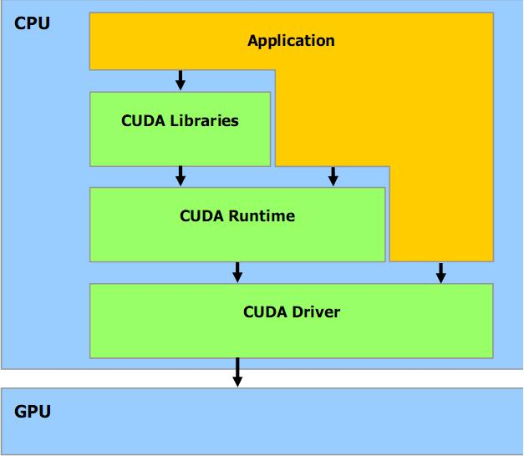
Introduction
Software Stack:
  Libraries:
CUFFT & CUBLAS
  Runtime:
Common component
Device component ( GPU)
Host component (CPU)
  Driver:
Driver API
Notes:
The hardware has been designed to support lightweight driver and runtime
layers.

Slide 10
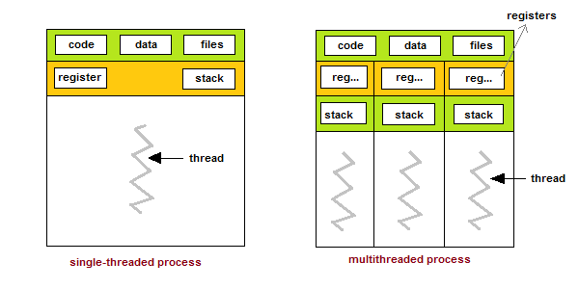
CUDA architecture
What is a thread ?
A thread is a single sequential flow of execution of tasks of a process.
What is multi threading?
- Multithreading is a model of program execution that allows for multiple threads to be created within a process, executing independently but concurrently sharing process resources.
Notes:
The hardware has been designed to support lightweight driver and runtime
layers.

Slide 11
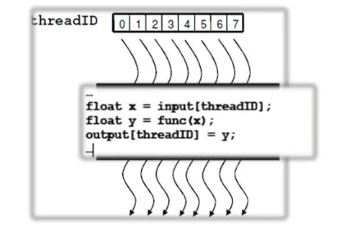
CUDA architecture
Arrays of parallel threads in CUDA.
A CUDA kernel is executed by an array of threads.
  All assigned threads run the same code.
  Each threads has its numeric ID that uses to compute the assigned task.
Execution function.
Notes:
The hardware has been designed to support lightweight driver and runtime
layers.

Slide 12
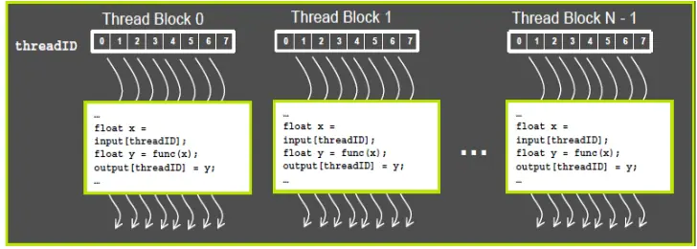
CUDA architecture
Some terminologies of Thread batching in CUDA
Thread Block: A group of threads.
Threads cooperates together using shared memory and synchronization.
Grid: Group of thread block
CUDA Grid
Notes:
The hardware has been designed to support lightweight driver and runtime
layers.

Slide 13
CUDA architecture
Some terminologies of Thread batching in CUDA
CUDA grid can be extended up to 3 dimensional.
For 1 dimensional grid map each thread index can be calculated as:
thread index, i= blockIdx.x*blockDim.x+threadIdx.x
blockIdx.x is the x dimension block identifier
blockDim.x is the x dimension of the block dimension
threadIdx.x is the x dimension of the thread identifier
Notes:
The hardware has been designed to support lightweight driver and runtime
layers.

Slide 14
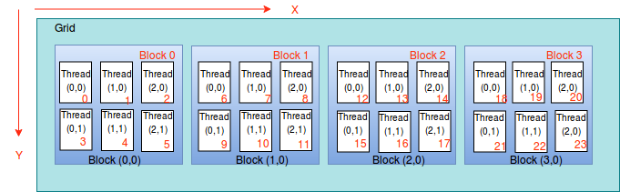
CUDA architecture
Some terminologies of Thread batching in CUDA
For 2 dimensional grid map each thread index can be calculated as:
threadId = (blockIdx.x * blockDim.x * blockDim.y) + (threadIdx.y * blockDim.x) + threadIdx.x
blockIdx.x is the x dimension block identifier
blockDim.x is the x dimension of the block dimension
threadIdx.x is the x dimension of the thread identifier
blockIdx.y is the y dimension block identifier
blockDim.y is the y dimension of the block dimension
threadIdx.y is the y dimension of the thread identifier
Notes:
The hardware has been designed to support lightweight driver and runtime
layers.

Slide 15
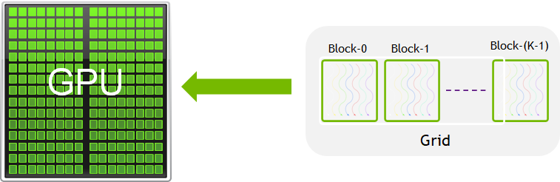
CUDA architecture
Some terminologies of Thread batching in CUDA
Notes:
The hardware has been designed to support lightweight driver and runtime
layers.

Slide 16
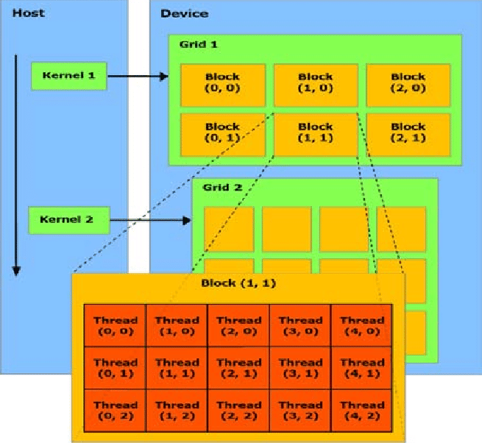
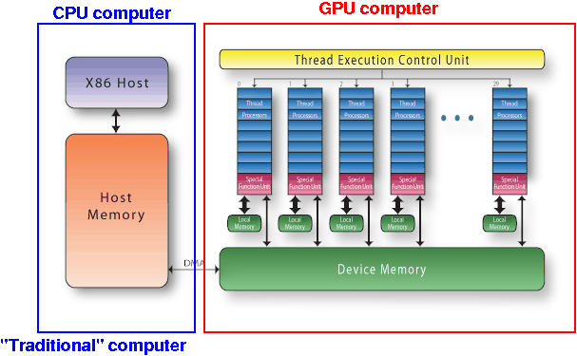
CUDA architecture
The compact diagram of CUDA architectecture
Notes:
The hardware has been designed to support lightweight driver and runtime
layers.

Slide 17
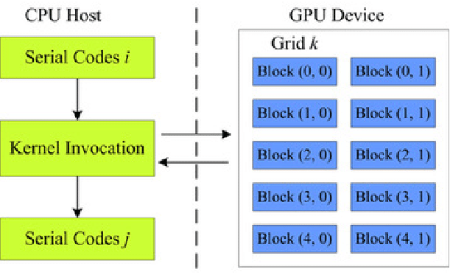
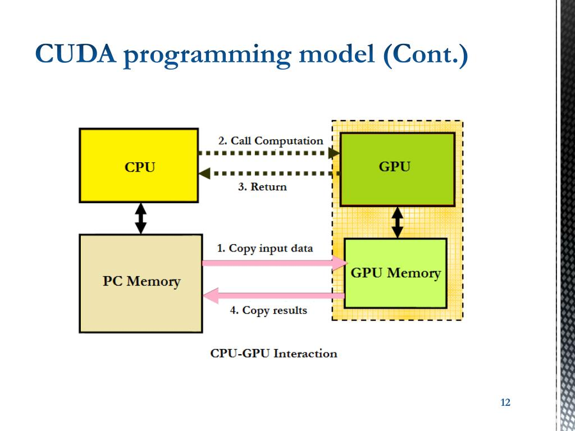
Programming Model through CUDA
Basis programming steps for CUDA programming :
Copy Input : Host memory device memory (host to device transfer)
Load the GPU program.
Define threads/block, blocks /grid and other parameters.
Launch the CUDA kernels and execute the GPU program.
Copy results : device memory Host memory (device to host transfer)
Notes:
The hardware has been designed to support lightweight driver and runtime
layers.

Slide 18
Programming Model through CUDA
CUDA kernel function qualifiers:
__device__
__global__
__host__
Example in C:
CPU program
void increment_cpu(float *a, float b, int N)
CUDA program
__global__ void increment_gpu(float *a, float b, int N)
Notes:
The hardware has been designed to support lightweight driver and runtime
layers.

Slide 19
Programming Model through CUDA
CUDA variable type qualifiers:
Specify how a variable is stored in memory
__device__
__shared__
__constant__
Example:
__global__ void increment_gpu(float *a, float b, int N)
{
__shared__ float shared[];
}
Notes:
The hardware has been designed to support lightweight driver and runtime
layers.

Slide 20
Programming Model through CUDA
Memory Transfer:
cudaMemcpy( void *dst, void *src, size_t nbytes, enum cudaMemcpyKind direction);
returns after the copy is complete blocks CPU
thread doesn’t start copying until previous CUDA calls complete
enum cudaMemcpyKind
cudaMemcpyHostToDevice
cudaMemcpyDeviceToHost
cudaMemcpyDeviceToDevice
Notes:
The hardware has been designed to support lightweight driver and runtime
layers.

Slide 21
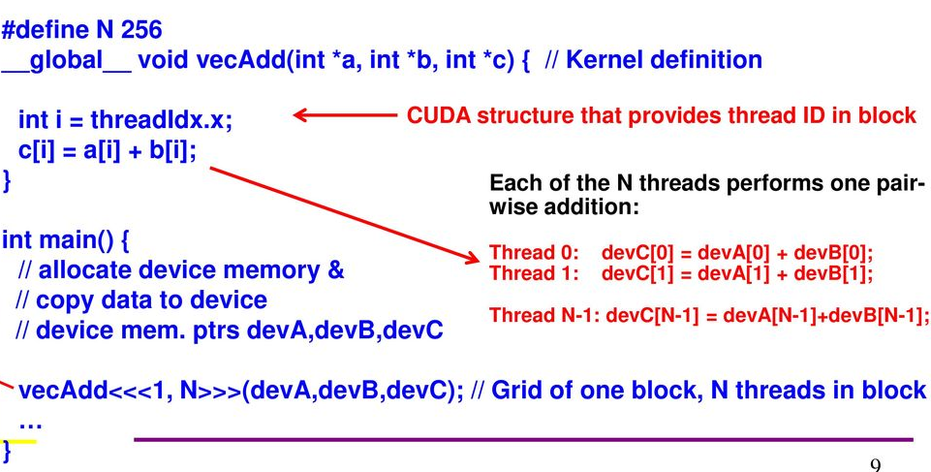
Programming Model through CUDA
Basis matrix addition program through CUDA
C programming implementation :
Notes:
The hardware has been designed to support lightweight driver and runtime
layers.

Slide 22
Programming Model through CUDA
Python Implementation of CUDA programming :
GPU Coding
CPU Coding
from numba import cuda
import numpy
import math
import time
# CUDA kernel
@cuda.jit
def cudavectorAdd(arr1,arr2,out):
x = cuda.grid(1)
if x < arr1.size:
out[x] =arr1[x]+arr2[x] # do the computation
# Host code
a = numpy.random.random(25000000)
b = numpy.random.random(25000000)
result = numpy.zeros(25000000)
threadsperblock = 256
blockspergrid = math.ceil(a.shape[0] / threadsperblock)
t1=time.time()
cudavectorAdd[blockspergrid, threadsperblock](a,b,result)
t2=time.time()
print(result)
print(" time to execution in CUDA", t2-t1)
import numpy
import math
import time
def cpuvectorAdd(a,b,result):
for i in range(len(a)):
result[i]=a[i]+b[i]
return result
a = numpy.random.random(25000000)
b = numpy.random.random(25000000)
result = numpy.zeros(25000000)
t1=time.time()
cpuresult=cpuvectorAdd(a,b,result)
t2=time.time()
print(cpuresult)
print(" time to execution in CPU", t2-t1)
Notes:
The hardware has been designed to support lightweight driver and runtime
layers.

Slide 23
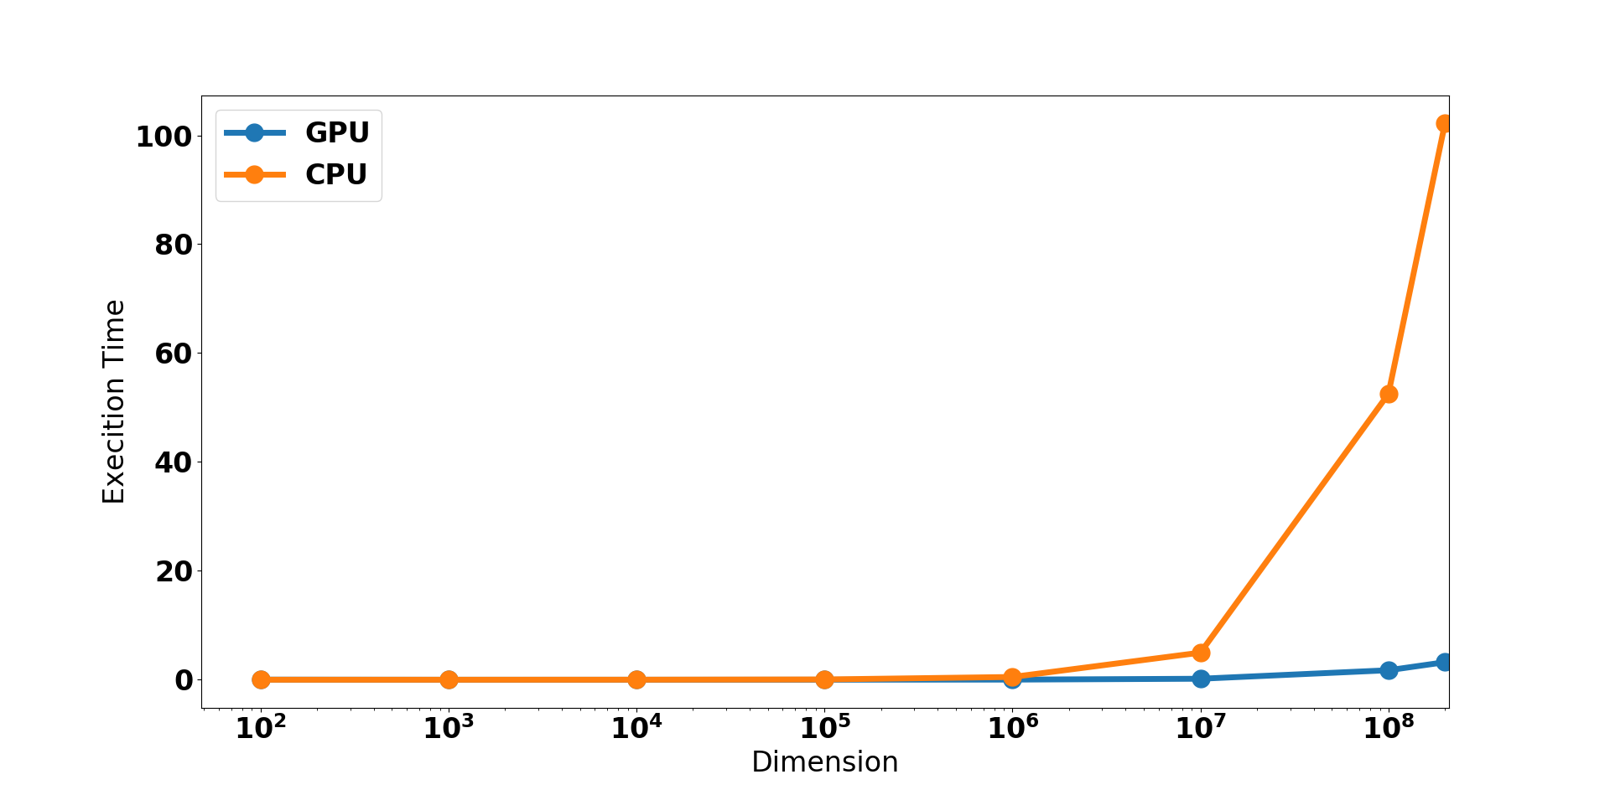
Programming Model through CUDA
Runtime comparison between CPU and GPU for vector addition
Notes:
The hardware has been designed to support lightweight driver and runtime
layers.

Slide 24
Programming Model through CUDA
Observations:
For lower dimension the CPU and GPU processing capability is at per.
But when the dimension is increasing the then the computational time is decreasing for GPU implementation.
Therefore, GPU is very efficient for massive computation paradigm.
Notes:
The hardware has been designed to support lightweight driver and runtime
layers.

Slide 25
Programming Model through CUDA
Do it yourself:
CUDA enabled matrix multiplication code and observe how the runtime varies with size of matrices.
CUDA enabled eigen value computation for huge matrices.
Notes:
The hardware has been designed to support lightweight driver and runtime
layers.

Slide 26
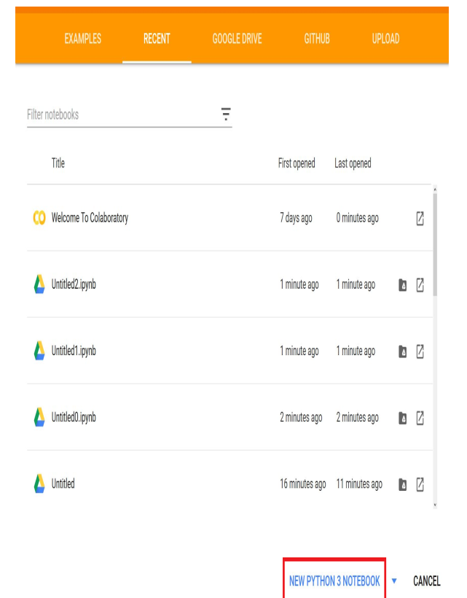
CUDA programming in Google-Colab
GPU coding at Google- Colaboratory Guide:
Assuming you already have a Google account, visit https://colab.research.g
oogle.com on your browser (Firefox or Chrome). The following interface
will appear:
Notes:
The hardware has been designed to support lightweight driver and runtime
layers.

Slide 27
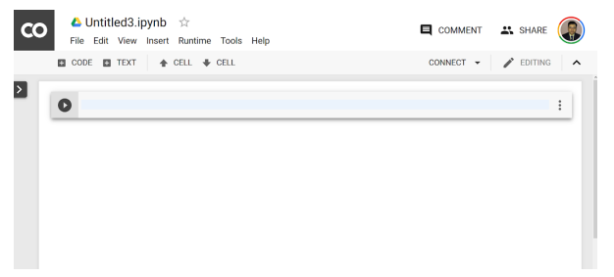
CUDA programming in Google-Colab
2. Now, you have access to a pre-configured and readily available Python
programming interface:
Notes:
The hardware has been designed to support lightweight driver and runtime
layers.

Slide 28
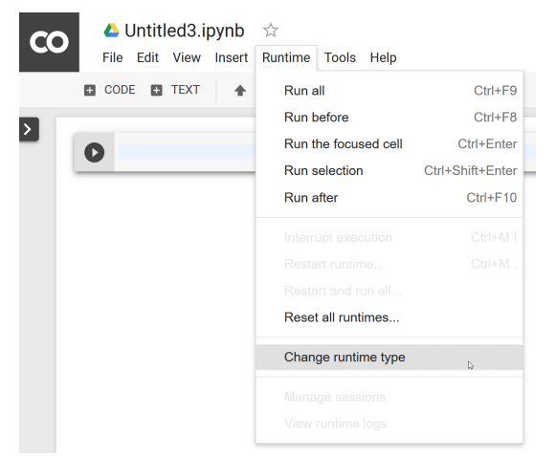
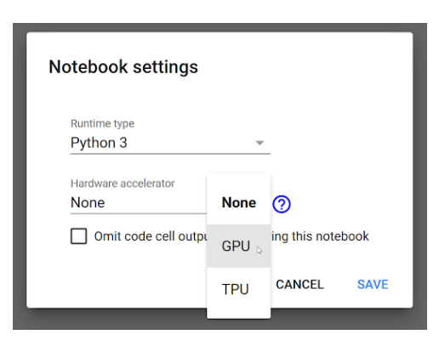
CUDA programming in Google-Colab
3. At this stage, our environment runtime does not have the GPU enabled by
default. So, let's change that setting to enable the GPU:
Notes:
The hardware has been designed to support lightweight driver and runtime
layers.

Slide 29
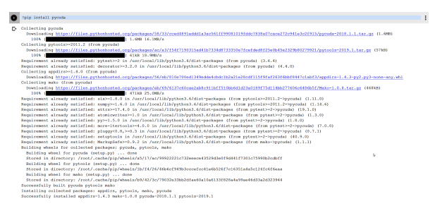
CUDA programming in Google-Colab
To install PyCUDA, let's use pip:
!pip install pycuda
Notes:
The hardware has been designed to support lightweight driver and runtime
layers.

Slide 30
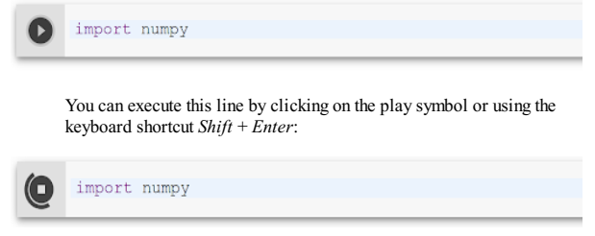
CUDA programming in Google-Colab
Lets start writing code in the notebook!!
Notes:
The hardware has been designed to support lightweight driver and runtime
layers.

Slide 31



Any Queries???

